Slide 1
SMARTER SEARCHING
WITH LIBRARY DATABASES

Slide 2
Learning Outcomes
By the end of this session you should be able to:
Identify key search terms from your research topic and expand these using synonyms
Use effective search techniques, such as Boolean searching, in building a search statement
Filter, save and export your search results

Slide 3
What are databases and why use them?
A database is like an online catalogue
Library databases – specialist collections of thousands of books, journals, articles, newspapers and others
Most have search tools which allow you to be more precise in your search
Databases give fewer, more relevant results than using Library Search.
Library Search is also a database (of sorts)
It is the OU Library’s primary search tool
It has advanced search tools
Searches the majority of OU Library collections – not all

Slide 4
Where can I find databases in the OU Library?

Slide 5
Recap: Where can I find databases in the OU Library?
Over 500 databases containing information on a huge variety of subjects via the Library Resources page
Databases by type e.g. biographies, dictionaries, newspapers, books, articles
Databases by subject – ‘Selected resources for your study’ collection

Slide 6
Building a search statement

Slide 7
Keywords
Discuss the impact of junk food advertising on the health and obesity rates of British primary school children.

Slide 8
Keywords
Discuss the impact of junk food advertising on the health and obesity rates of British primary school children.

Slide 9
Synonyms
Words that mean exactly or nearly the same.
For example:
Hardworking: industrious, enterprising Attitude: outlook, stance
Discuss the impact of junk food advertising on the health and obesity rates of British primary school children.

Slide 10
Synonyms
Discuss the impact of junk food advertising on the health and obesity rates of British primary school children.
junk food: chocolate, fast food, sweets, chips, burgers
advertising: marketing, promotion, publicity
health: wellbeing, fitness
obesity: overweight, weight, BMI
British: United Kingdom, English, Scottish, Welsh, Northern Irish
children: kids, young people, adolescent, youngster

Slide 11
Advanced Searching Techniques

Slide 12
Phrase Searching
Use “double quotes” and the search tool will search for those words together in that order.
Like “United Kingdom” or “higher education”
junk food
10,432 results
“junk food”
3,571 results

Slide 13
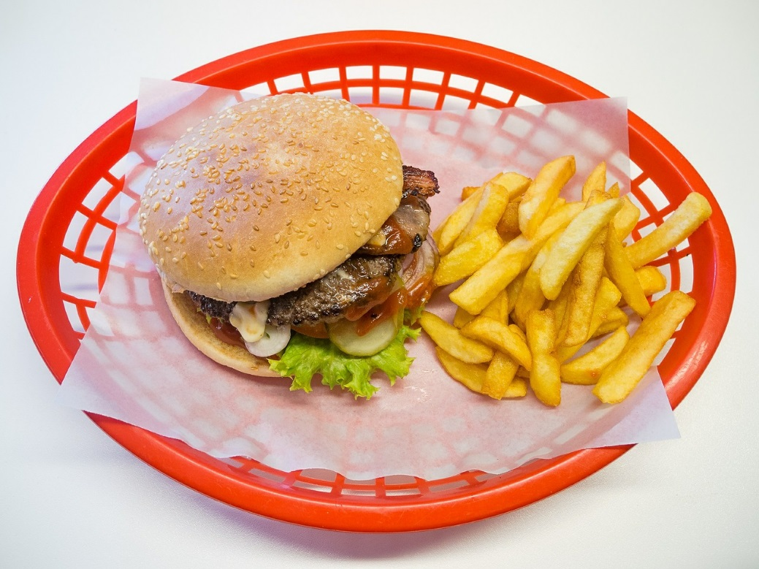
Field Searching
“junk food”
All fields = 1,968
Author = 0
Article Title = 505
Abstract = 1,162
Keywords = 97
Image source: Pixabay (CC0 Creative Commons)
Notes:
Once we decide that we are ready to begin searching within a database, if we don’t specify where to search, the database will find our search terms wherever they occur in the full text, the title, the keywords.
We can make the database search just a particular part of the record – this is called field searching.
I tested this earlier in the database Academic Search Complete * , using the phrase search, “junk food” – and as you can see, depending on where I limit my search to can really make a difference to how many results I get.
* Search conducted 07/08/18

Slide 14
Boolean Searching
Use search operators to reduce or increase the number of results.
AND
fewer results
OR
more results
NOT
fewer results

Slide 15
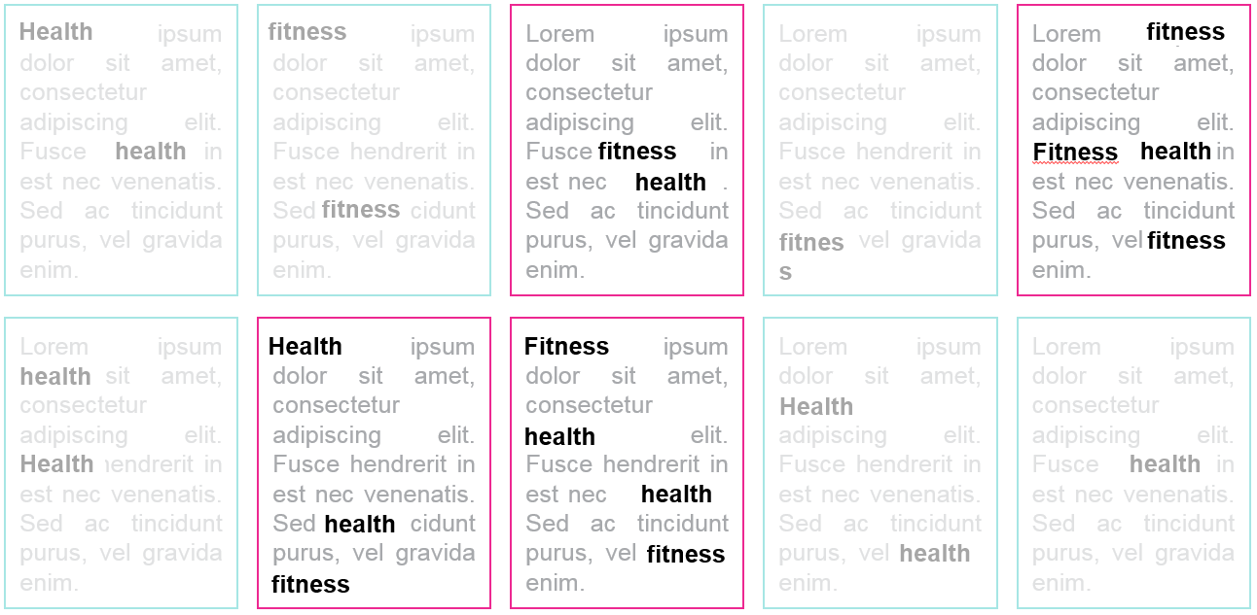
Boolean Searching
AND (fewer)
Using AND you will only find documents that have BOTH of your keywords. This will limit the number of your results.
health AND fitness

Slide 16
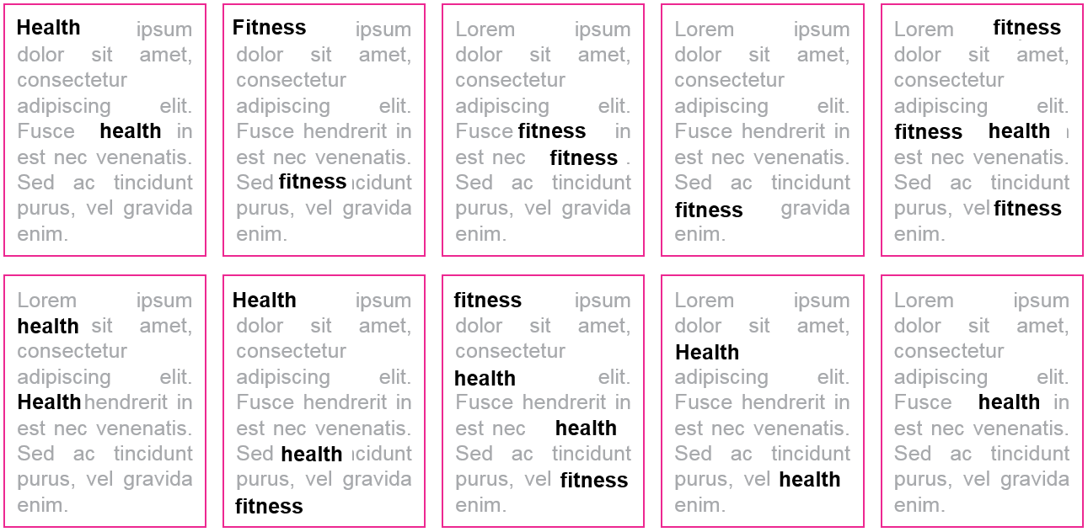
Boolean Searching
OR (more)
Using OR you will find any document that contains either one of your keywords or both. This will increase the number of your results.
health OR fitness

Slide 17
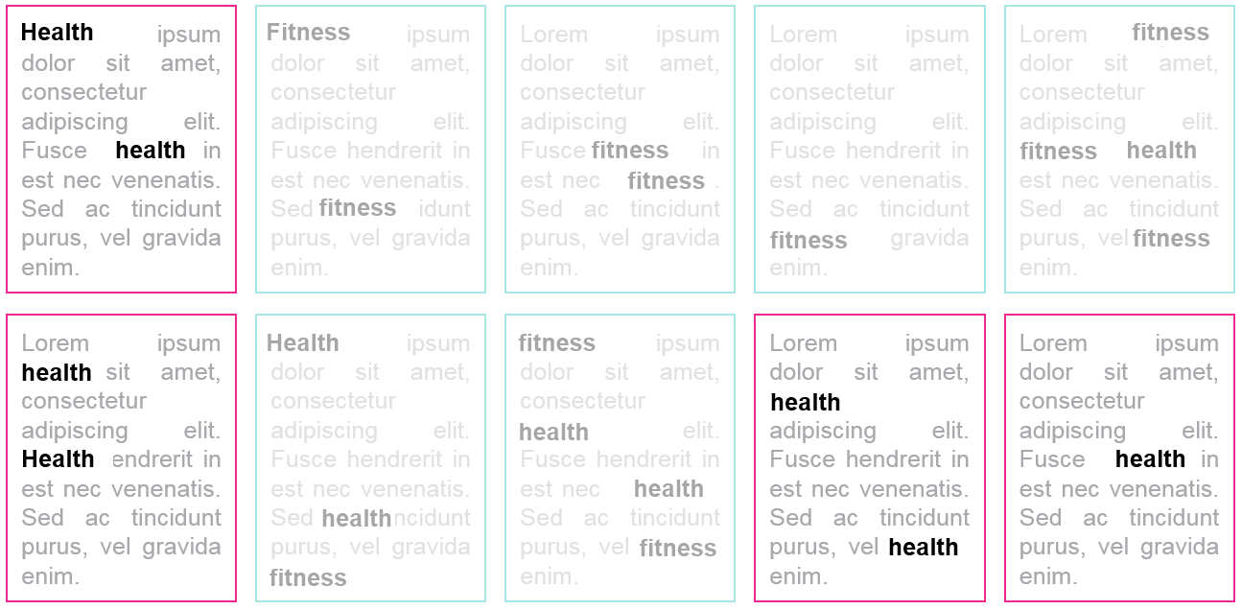
Boolean Searching
NOT (fewer)
Using NOT you can retrieve results that don’t contain a particular keyword. This will limit the number of your results.
health NOT fitness

Slide 18
Truncation
A searching technique in which a word ending is replaced by a symbol – normally an asterisk (*) Searches for different forms of the same word and can expand your search results.
advert*
advertising, advertisement
child*
children, childhood, childish

Slide 19
Building a search statement
phrase searching
truncation
Boolean operator
“junk food” AND advert* AND (health OR obes*) AND (child* OR “primary school”)

Slide 20
Managing your results
Most databases have search limiters (filters) that allow you to narrow your results.
Most databases have built-in tools that allow you to print and download your results
Most databases have an option to ‘export’ results to reference management tools

Slide 21
Your turn…
Spend 10 minutes constructing a search statement.
You can use your own topic, or the one below:
Discuss the benefits of using art as a therapy for children with learning disabilities.
Don’t forget…
Keywords
Synonyms
Phrase Searching
Boolean Logic
Truncation

Slide 22
We have covered…
You should now be able to:
Identify key search terms from your research topic and expand these using synonyms
Use effective search techniques, such as Boolean searching, in building a search statement
Filter, save and export your search results

Slide 23

Help!
If at any point during your studies you have problems using library databases or finding information, please remember the library helpdesk is there for you.
Webchat (24/7)
http://www.open.ac.uk/library/help-and-support/contacting-the-helpdesk
Email
lib-help@open.ac.uk
Phone
+44 (0)1908 659 001
Image source: iStock

Slide 24

Fill in the feedback form for a chance to win
a £20 Amazon voucher!
Image source: Pixabay (CC0 Creative Commons)

Slide 25
Any questions?

